Slide 1
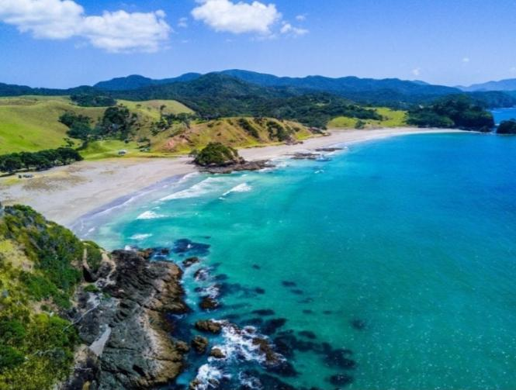
Maori
By:Aoife Mc Phelim

Slide 2
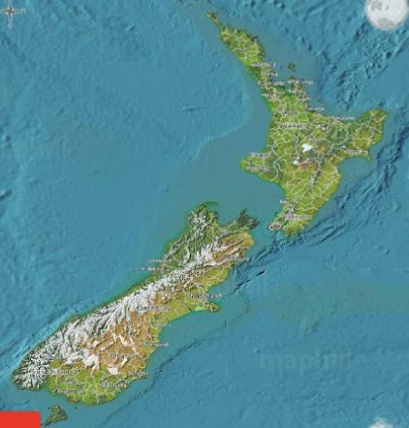
The Maori are a group of people who settled on the islands of New Zealand in around AD 1300.
They called the island of New Zealand ‘Aotearoa’ which means the land of the long white cloud.
The maori people are from the Polynesian islands.

Slide 3
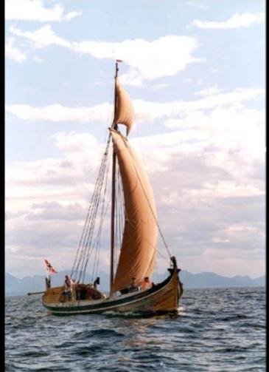
Maori means original people. The Maori leader Kupe led the people to the island in boats.

Slide 4
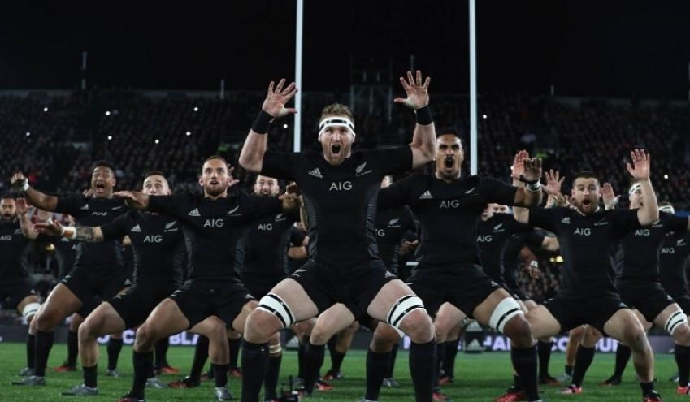
The Haka is a dance used by the Maori warriors to show off their strength and it is the same dance New Zealand use today before they play rugby.

Slide 5
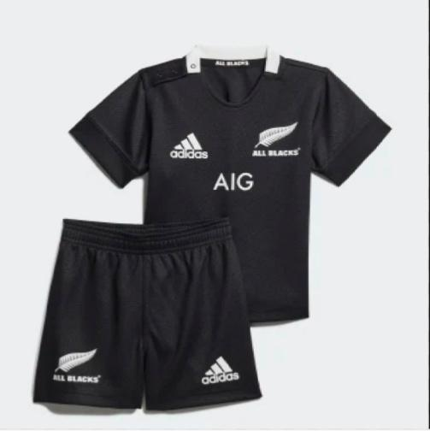
New Zealand rugby team is also known as the All Blacks because of the colour of their jerseys

Slide 6
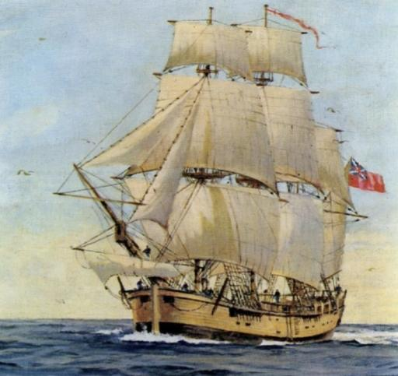
Around 100,000 Maoris
were living in New Zealand when the English came in 1768 he was called Captain James Cook his ship was called HMS Endeavour.

Slide 7
Tupaia was a priest and a translator that led James Cook to New Zealand.
The Europeans brought disease and mistreated the Maoris which caused thousands of Maoris to die. In the 18 hundreds some Maori tribes went to war with each other. It is now known as the Musket War and 40,000 Maoris died.

Slide 8
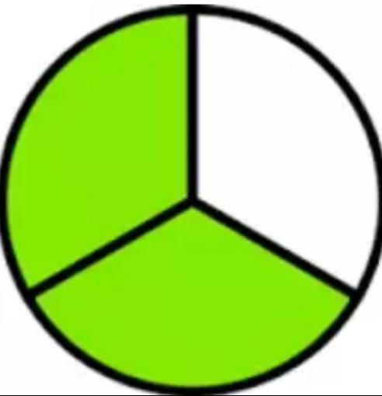
By the 1840 ⅔ of Maori were Christian.

Slide 9
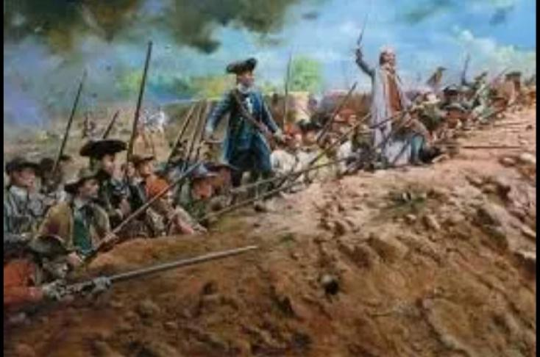
After the war the British took rule of the country in 1840.

Slide 10
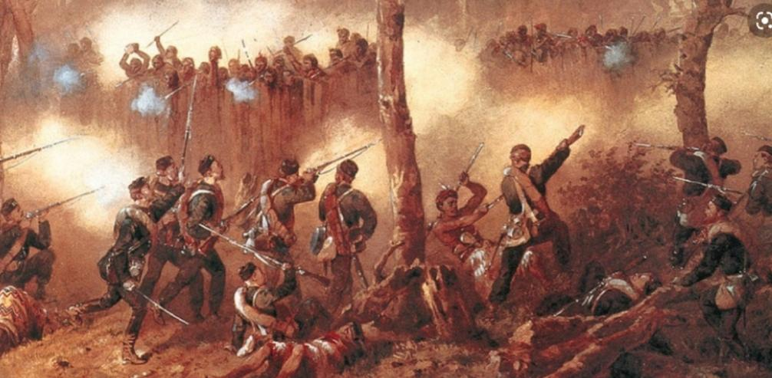
Over the next 30 years the Maoris fought back but the
Europeans outnumbered them.

