Slide 1
THE MAORI PEOPLE
Five Traditions

Slide 2
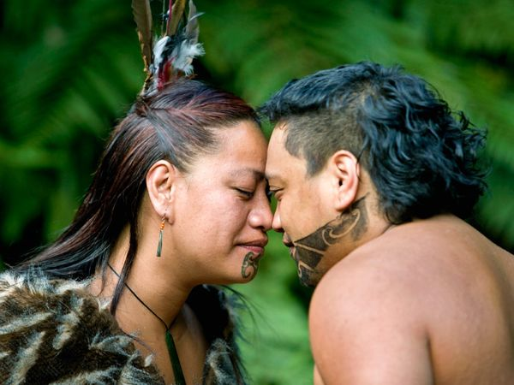
HONGI
A gesture of respect, the Hongi is a traditional greeting done by pressing the nose and forehead against someone else's. It’s like us doing a handshake.

Slide 3
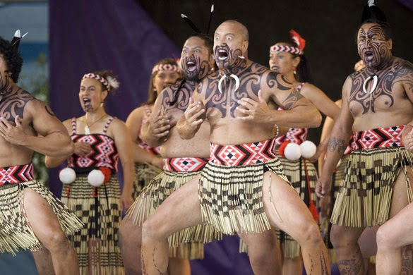
HAKA
The Haka is a Maori war dance that was traditionally saved for the battlefield. It has been made popular by the New Zealand All Blacks who have turned it into an important cultural event on the world stage. The action packed dance is a display of strength and pride which includes powerful stomps of the feet, wide eyes and tongue poking.

Slide 4
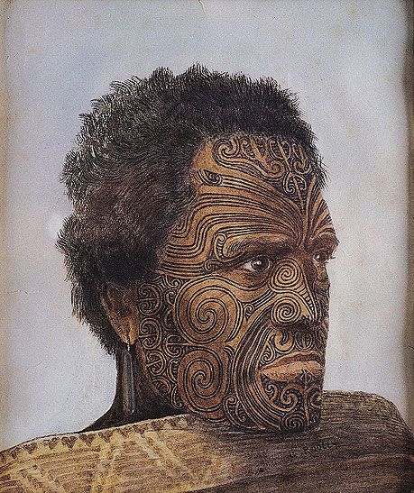
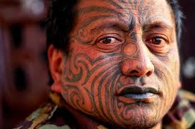
TAMOKO
Theses tattoos are most commonly worn on faces, bottoms and thighs for men and on the lips and chins for women. In the early days the tattoos were carved into the skin using a sharp implement usually made from bone or sharks teeth which was coated in ink. The Maori people considered to be the most sacred part of the body and this is why the face and head is a popular place for tattoos.

Slide 5
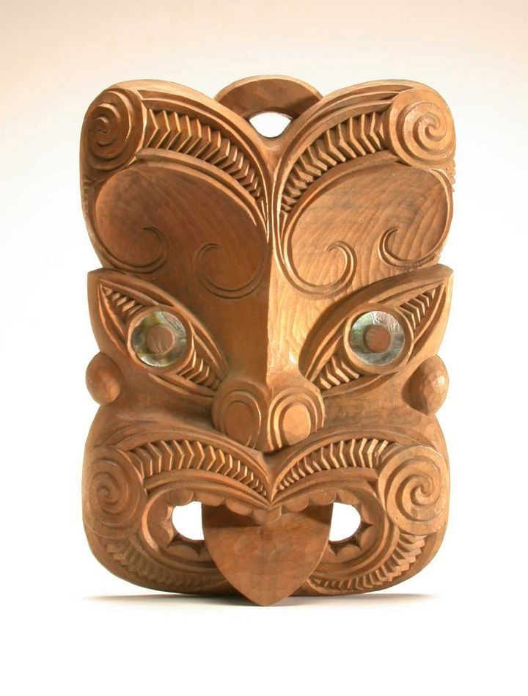
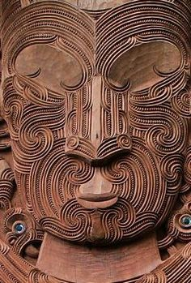
WHAKAIRO
The Whakairo is the Maori art of carving which tells an important story. These stories are passed down from the generations and are generally carved by men on a series of objects like weapons, tools ,buildings and canoes.

Slide 6
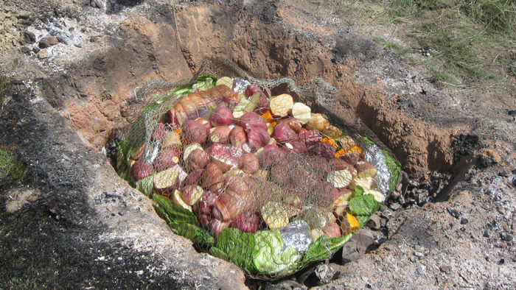
HANGI
This is a method of cooking used by the Maori culture. It includes preparing meats, potatoes and vegetables and placing them into a pit dug into the ground on top of hot stones. This method is generally reserved for special occasions.

