Slide 1
The Maori People
By Corey McGarrigle

Slide 2
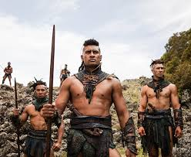
About
Māori are the tangata whenua, the indigenous people, of New Zealand. They came here more than 1000 years ago from their mythical Polynesian homeland of Hawaiki

Slide 3
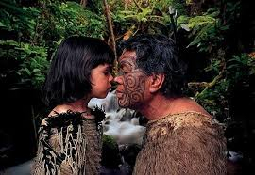
We greet each other by pressing our noses and foreheads together

Slide 4
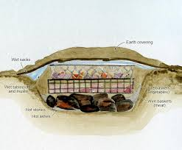
We cook our food under the ground!!
.The Hangi (not to be confused with the Hongi!) is a feast cooked within an earth oven for several hours. We heat stones in the embers of a fire, and dig a pit where the hot stones are placed along with wet sacking. Then, we place our food on top – think chicken, lamb, pork and vegetables – before covering it with earth to trap the heat. The Hangi is an awesome way to feed a large group of people, and the smoky, earthy fragrance of the food is delicious.

Slide 5
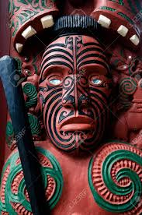
Maori Language
Instead of books and literature, we passed our stories down through the generations by song (Waiata) and used a lot of symbolism in carving, knots and weaving.

Slide 6
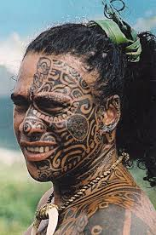
Maori Tattoo
Each Ta Moko (Māori Tattoo) is incredibly unique, communicating tribal messages from ancestors around things like family, tribal affiliations and the wearer’s social standing.

Slide 7
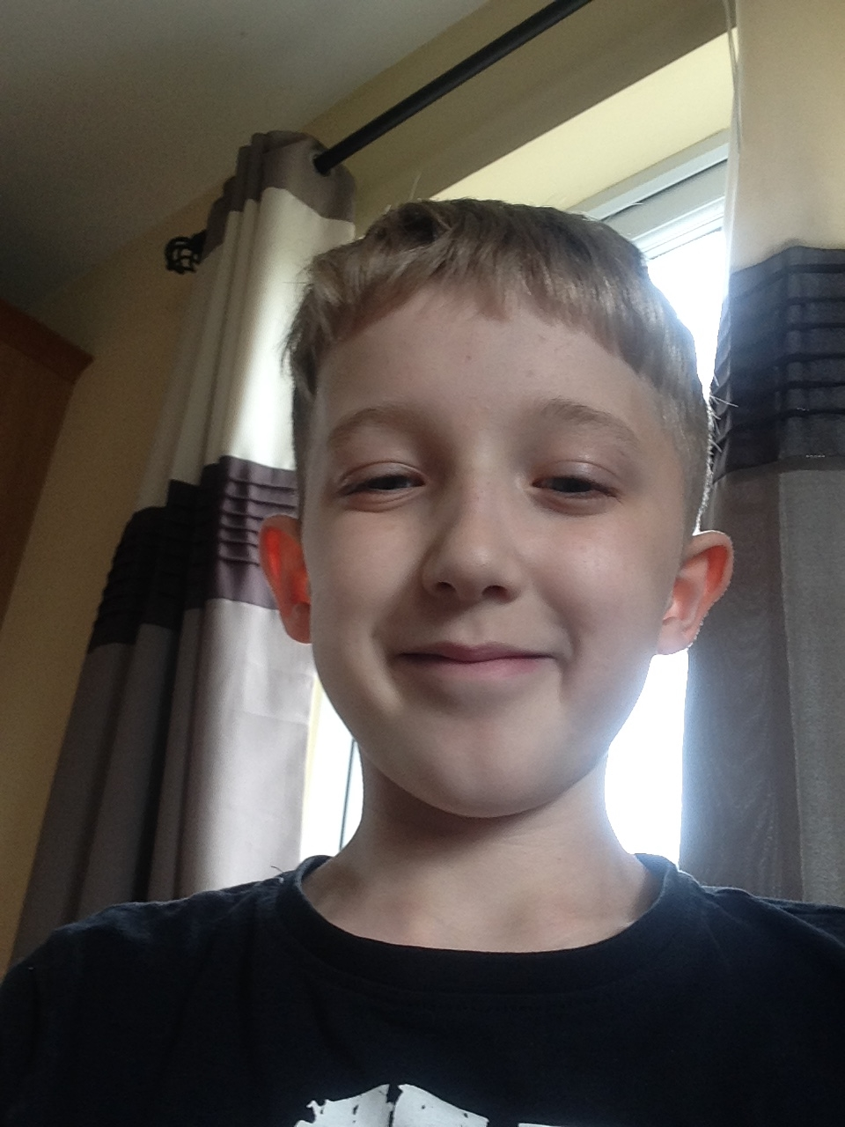
Hope you enjoyed my slideshow on the Maori People.
The End

